Slide 1
Mid-Year Design Review
Team 1 (AutoUmp)
December 9th, 2016
Notes:
30 minutes for ppt + demo
20 minutes for evaluator Q&A
From eval: “Once hardware is selected, estimate performance including communication cost.”
We know we need to update the block diagr

Slide 2




The Team
Timothy Adams
CSE
Justin Marple
CSE
Jason Camiel
EE
Matt Barnes
EE
Notes:
- block diagram
- cameras/boards to buy (jason/justin)
- fill in with matlab slides
- put in enclosure (jason)
- android app
- test cases/data collection (jason?)
- cdr deliverables
- timetable
- synchronization figure (barnes' code)
I think the way the matlab code is written and does it's checks- it will never recognize a pitch if the right camera is recording frames earlier than the left camera

Slide 3
The Problem
Determining strikes and balls without a professional umpire is difficult and inaccurate
Current technology solutions are expensive and require extensive set-up
Incorrectly called pitches lead to angry players

Slide 4
The Solution
Use a stereo camera and image processing system built into the home plate to determine the baseball’s location
Challenges:
Time restrictions for bulk of image processing (16.2ms)
High accuracy required for successful use (~95%)
Ball detection vs. object detection (e.g. bat)

Slide 5
Block Diagram - Hardware
Notes:
- It may be helpful to show the block diagram before you into a particular component. You can highlight that component on the diagram so that people know what you are talking about.

Slide 6
MDR Deliverables
Demonstration of core image processing algorithm in MATLAB
Returns x, y position of ball above plate given two .MOV files
Demonstration of image collection
Create two synchronized video feeds using cameras and collect with processor

Slide 7
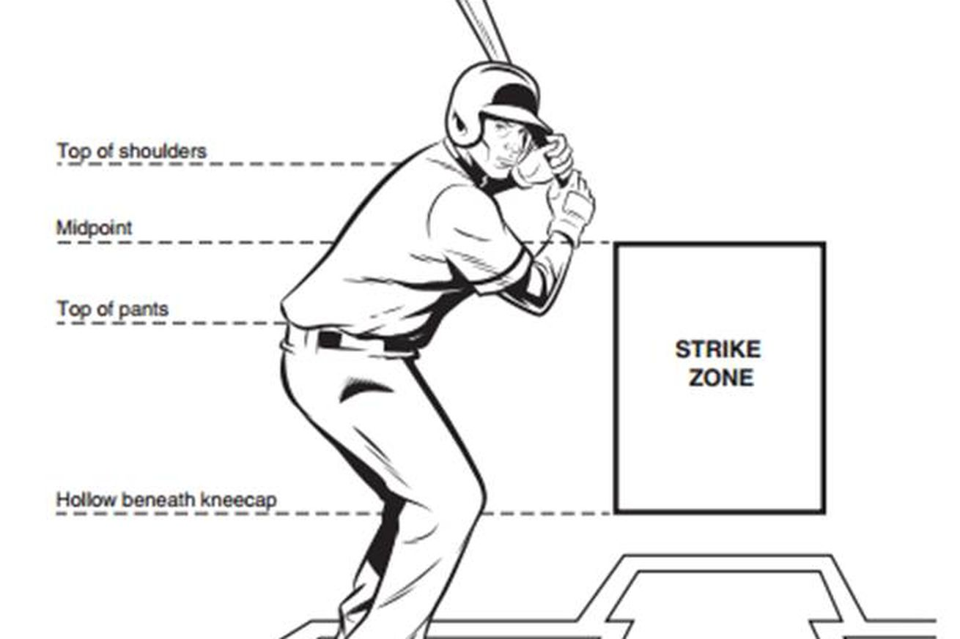
Strike Detection Concept
Locate point in 3D space where ball intersects with the “Strike Zone” plane

Slide 8
Block Diagram - Software
Notes:
- It may be helpful to show the block diagram before you into a particular component. You can highlight that component on the diagram so that people know what you are talking about.

Slide 9
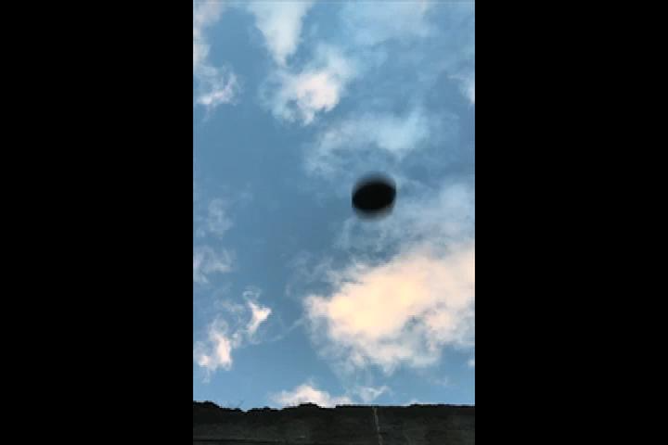
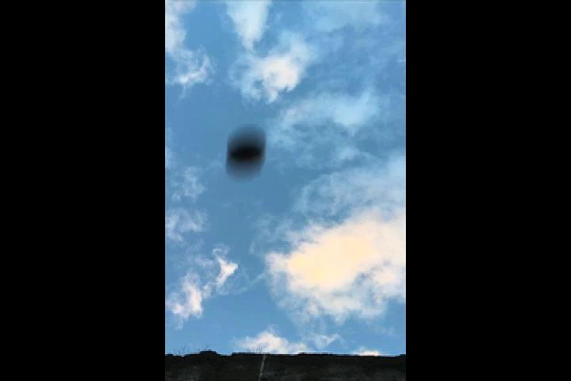
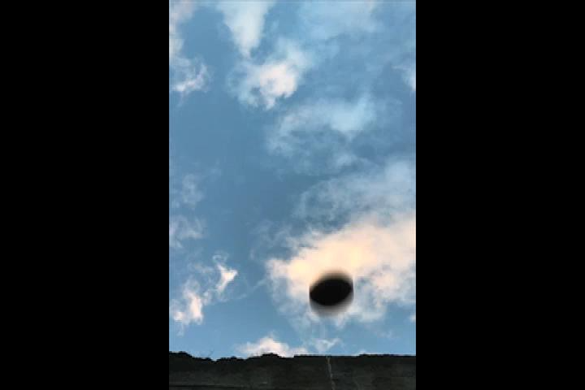
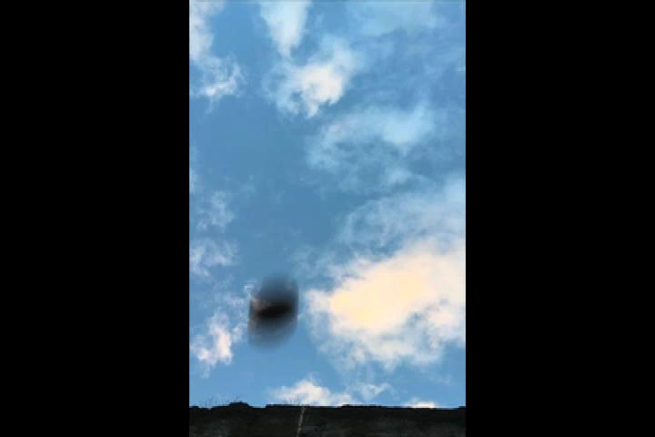
The Algorithm – Input
Left:
Right:
t
Notes:
Right now the left/right images are the same – won’t be the case in the actual presentation
“189 minus 188.png” in Google Drive -> SDP -> Experiments -> Background Subtraction -> Output_Enhanced

Slide 10
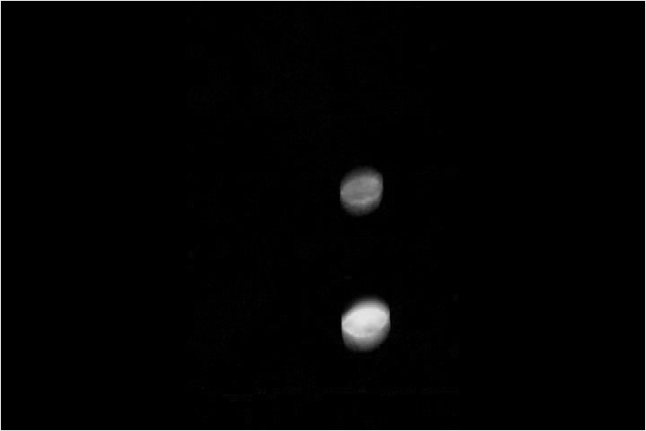
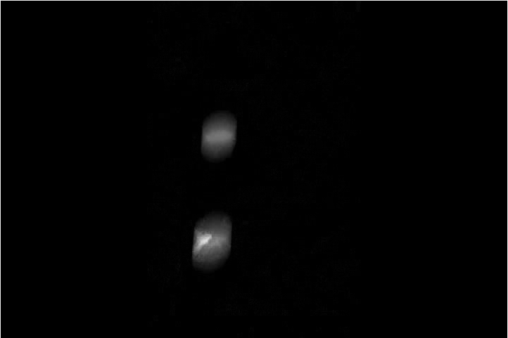
The Algorithm – Background Subtraction
Left:
Right:
Notes:
“189 minus 188.png” in Google Drive -> SDP -> Experiments -> Background Subtraction -> Output_Enhanced

Slide 11
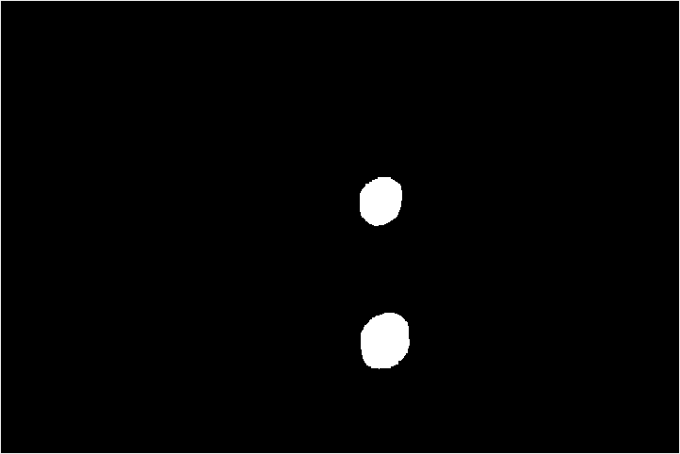
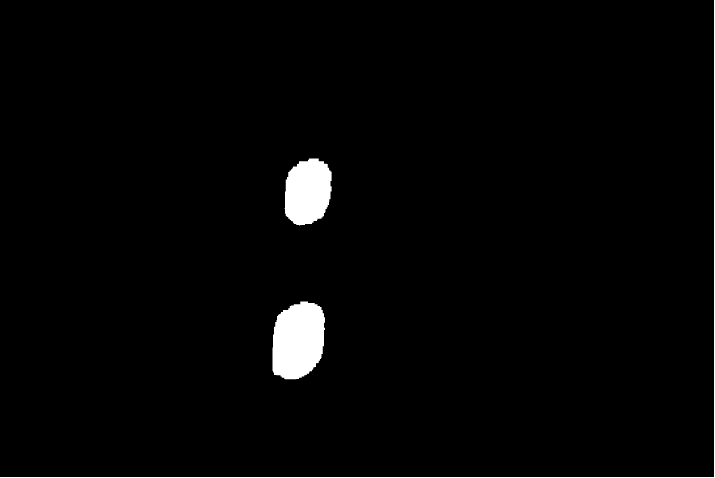
The Algorithm – Filter and Enhance
Left:
Right:
Notes:
“189 minus 188.png” in Google Drive -> SDP -> Experiments -> Background Subtraction -> Output_Enhanced

Slide 12
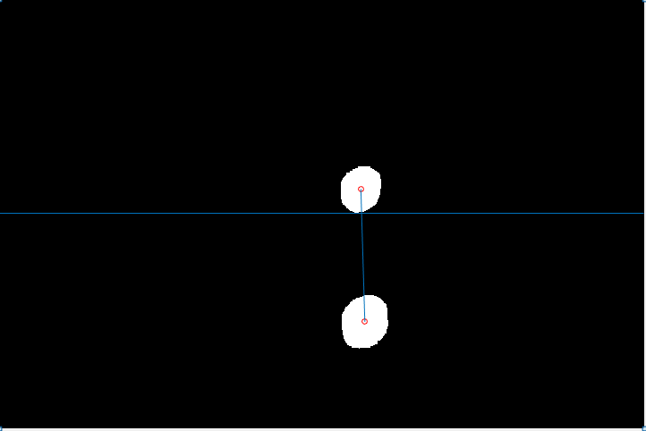
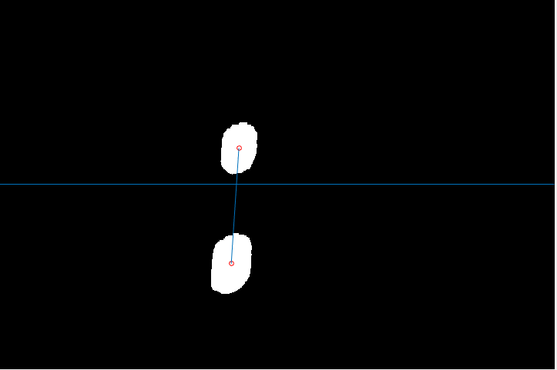
The Algorithm – Intersection with Strike Zone
Left:
Right:
Notes:
Balls will be circled by the MATLAB algorithm.
If balls are on left/right side of center pixel line – cointinue processing. Else, wait. (guaranteed to have this situation if >2 frames is guaranteed)
[“189 minus 188.png” in Google Drive -> SDP -> Experiments -> Background Subtraction -> Output_Enhanced]

Slide 13
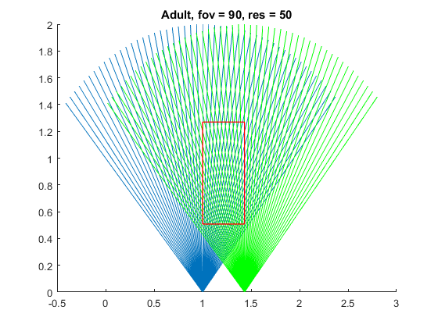
The Algorithm – Find Centroid Pixel
Notes:
Image will be replaced by one that Barnes is creating through his MATLAB algorithm, which will have only the two lines that intersect to find the ball

Slide 14
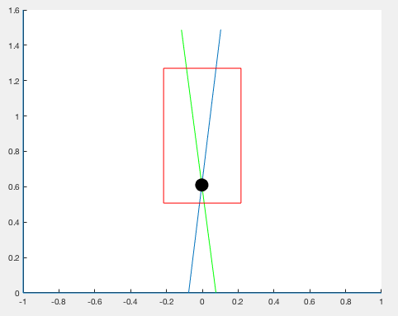
The Algorithm – Determine Ball Location
Notes:
Image will be replaced by one that Barnes is creating through his MATLAB algorithm, which will have only the two lines that intersect to find the ball

Slide 15
A Word on Synchronization
Notes:
Basically – synchronization is not necessary because each camera can calculate the intersection of the ball with the strike zone on its own, shoot that information off to a separate process

Slide 16
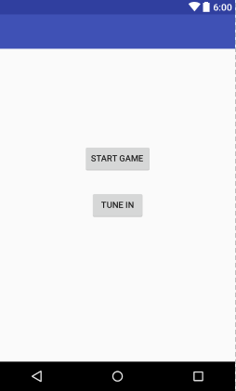
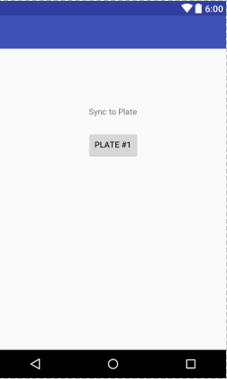
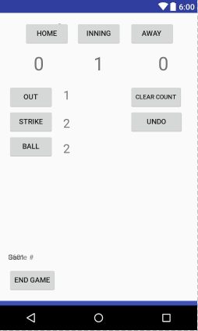
Android App UI

Slide 17
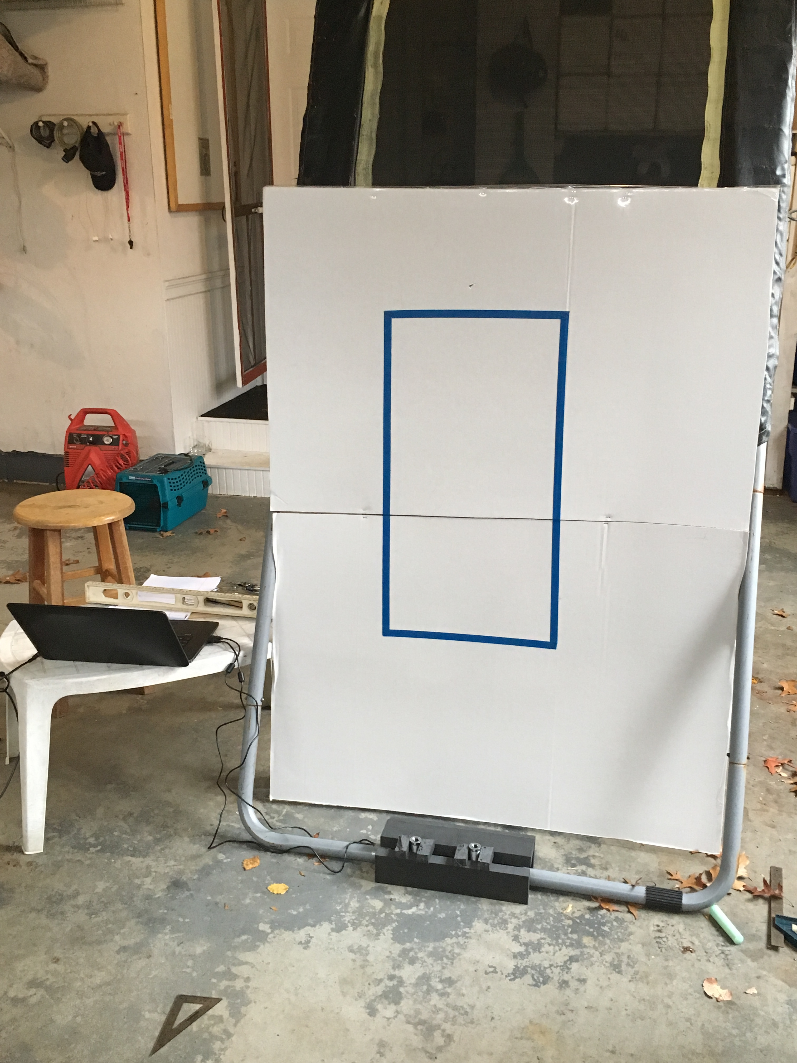
Indoor Garage testing
Choose aperture and exposure time for outdoor use
Cameras will need to be securely fastened to the plate in addition to each other
Frame rate of 60fps required for accurate testing
Notes:
In attempt to do outdoor tests, cameras output were white washed due to aperture
Cameras were fixed to strike zone backboard, which caused movement with ball and rendered most results useless
Streaking ball due to speed of throw for location accuracy.

Slide 18
Wall Testing
Using two iPhones spread 6 inches apart and defined axis on a cement wall.
Marked and measured pitches using chalk on the wall
The data collected is used to perform validation of the location algorithm
Sources of error that will affect perfect validation include
Camera movement/angle orientation
Ball arc between camera and mark on wall a distance of approximately 18 inches.
Human error in the marking of the position on wall

Slide 19
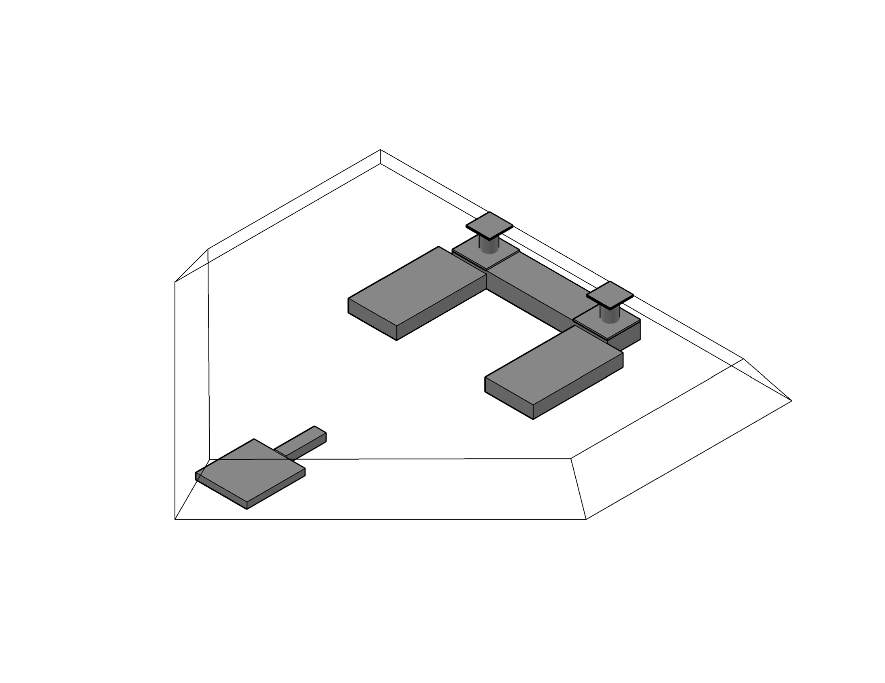
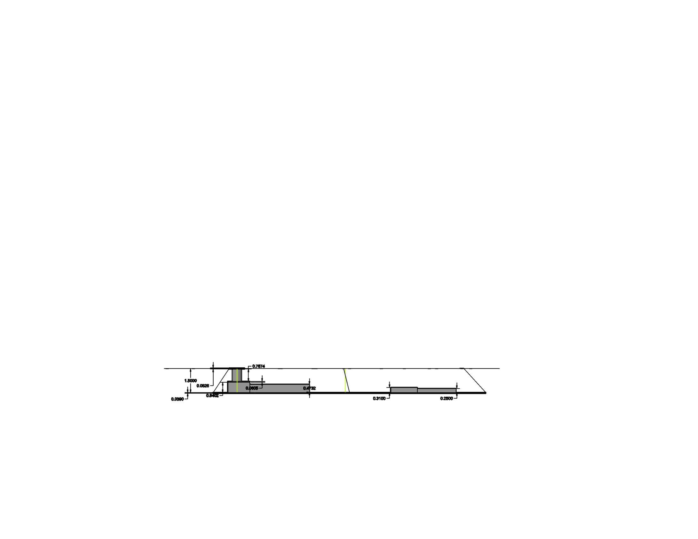
Enclosure

Slide 20
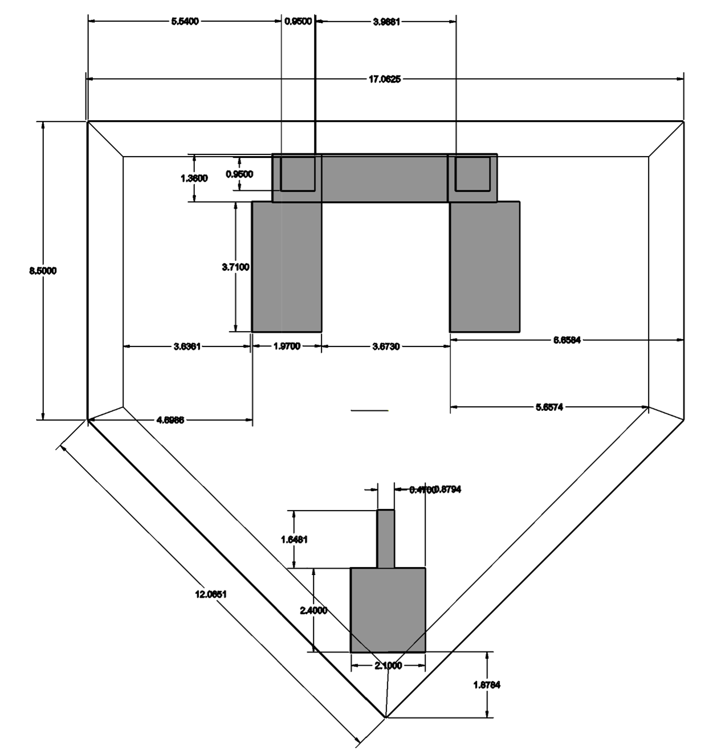
Enclosure Top View

Slide 21
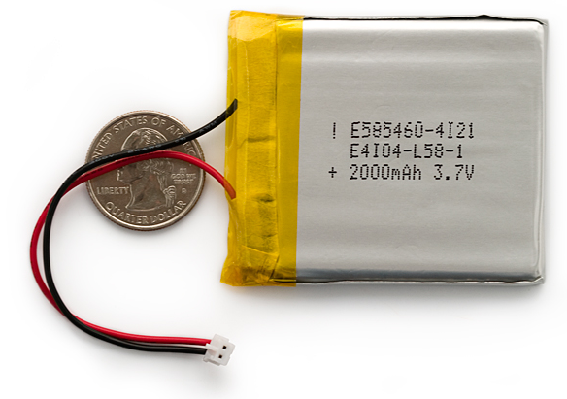
Power Requirement
Power consumption for processors
3.7V*0.45A = 1.65W
4 hour game time: 6.75Wh
Charge: 1824mAh
Result: Choose a 2000mAh battery

Slide 22
Required Parts List
OV7740 Camera Chip (x2)
60fps
SCCB Interface
XEF216-512-TQ128 (x2)
2MB flash
512kB RAM
16 cores
OV7440 Lens (x2)
OV7440 Mount (x2)
2000mAh battery

Slide 23
CDR Deliverables
Demonstrate complete system functionality
Implement ball detection, strike zone intersection, and baseball height functions in C (Tim)
Functioning PCBs (Justin)
Capable of detecting balls/strikes with hardware at 60fps
Implement full app functionality (Jason)
Pair to plate, complete viewer and umpire views
2-way Bluetooth communication established
App receives ball/strike information
Plate receives batter height
First iteration of enclosure built (Matt)
Notes:
Note: CDR 2/27 – 3/10

Slide 24
Timeline
Complete orders for final system
Design and send out order for PCB
Implement full algorithm in C
Achieve image collection on PCB system
Receive second round of PCB if needed
Bluetooth communication established
App functionality completed
Implement full algorithm in XC
Enclosure completed
Dec 21st
Jan 21st
Feb 21st
Feb 28th
Notes:
Note: CDR 2/27 – 3/10

Slide 25
Demo – Image Collection and Object Detection
Image size: 176x144
Frames per second: 30 -> ~33.3 ms/frame
Limited memory space: can only store two images at a time

